Slide 1
Lesson 3
Declaring PL/SQL Variables

Slide 2
Objective
In this lesson we will cover the following :
Recognize valid and invalid identifiers
List the uses of variables
Declare and initialize variables
List and describe various data types
Identify the benefits of using the %TYPE attribute
Declare, use, and print bind variables

Slide 3
Lesson Agenda
Introducing variables
Handling variables of different types
Using the %TYPE attribute and composite data types
Using bind variables

Slide 4
Variables
Are labeled storage locations
Are used to store and process data in a PL/SQL block
Can hold different types of data
Should declare variables before using them in the PL/SQL block
Notes:
Java SE 8 Programming 2 - <number>

Slide 5
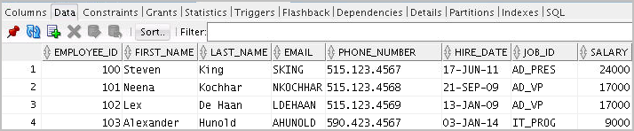
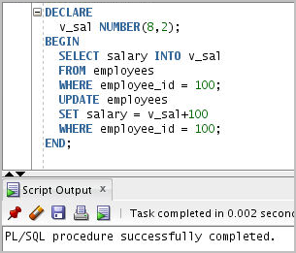
Variables in PL/SQL

Slide 6
Requirements for Variable Names
A variable name:
Must start with a letter
Can include letters or numbers
Can include special characters ($, _, #)
Must contain no more than 30 characters
Must not include reserved words

Slide 7
Using Variables in PL/SQL
Variables are:
Declared and (optionally) initialized in the declaration section
Used and assigned new values in the executable section
Passed as parameters to PL/SQL subprograms
Used to hold the output of a PL/SQL subprogram

Slide 8
Declaring and Initializing PL/SQL Variables
Syntax:
identifier [CONSTANT] datatype [NOT NULL]
[:= | DEFAULT expr];
Examples
DECLARE
v_hiredate DATE;
v_location VARCHAR2(13) := 'Atlanta';
v_deptno NUMBER(2) NOT NULL := 10;
c_comm CONSTANT NUMBER := 1400;

Slide 9
Declaring and Initializing PL/SQL Variables
DECLARE
v_myName VARCHAR2(20);
BEGIN
DBMS_OUTPUT.PUT_LINE('My name is: '||v_myName );
v_myName := 'John';
DBMS_OUTPUT.PUT_LINE('My name is: '||v_myName );
END;
/
DECLARE
v_myName VARCHAR2(20):= 'John';
BEGIN
v_myName := 'Steven';
DBMS_OUTPUT.PUT_LINE('My name is: '|| v_myName);
END;
/

Slide 10
Initializing Variables Through a SELECT Statement
Retrieve data from the database with a SELECT statement
Syntax:
SELECT select_list
INTO{variable_name[, variable_name]...}
FROM table
[WHERE condition];

Slide 11
Types of Variables
  PL/SQL variables:
    Scalar
    Reference
    Large object (LOB)
    Composite
  Non-PL/SQL variables: Bind variables

Slide 12
Declaring Variables
DECLARE
v_emp_job VARCHAR2(9);
v_count_loop BINARY_INTEGER := 0;
v_dept_total_sal NUMBER(9,2) := 0;
v_orderdate DATE := SYSDATE + 7;
c_tax_rate CONSTANT NUMBER(3,2) := 8.25;
v_valid BOOLEAN NOT NULL := TRUE;
...

Slide 13
Guidelines for Declaring and Initializing PL/SQL Variables
  Follow consistent naming conventions.
  Use meaningful identifiers for variables.
  Initialize variables that are designated as NOT NULL and CONSTANT.
  Initialize variables with the assignment operator (:=) or the DEFAULT keyword:
  v_myName VARCHAR2(20):='John';
  v_myName VARCHAR2(20) default ‘John’;
  Declare one identifier per line for better readability and code maintenance

Slide 14
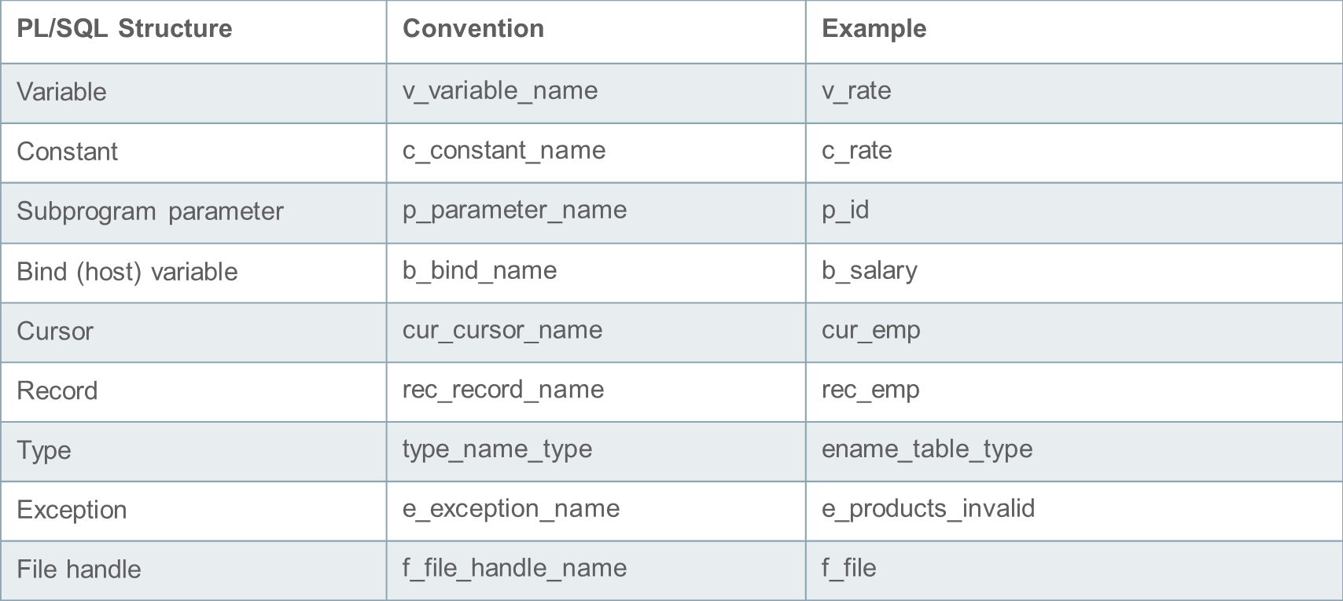
Naming Conventions of the PL/SQL Structures Used in This Course

Slide 15
Data Types for Strings
  A string is a sequence of symbols that are part of a character set. To declare a string variable, PL/SQL offers:
    CHAR
    NCHAR
    VARCHAR
    NVARCHAR
    CLOB
    NCLOB

Slide 16
Data Types for Numeric values
  PL/SQL offers different numeric data types to suit different purposes:
    NUMBER
    PLS_INTEGER
    SIMPLE_INTEGER
    BINARY_INTEGER
    BINARY_FLOAT
    BINARY_DOUBLE
    BOOLEAN (TRUE, FALSE or NULL)
    BOOLEAN is a non-numeric data type, which can assume one of the three values – TRUE, FALSE or NULL

Slide 17



Data Types for Date and Time values
  The Oracle database provides three data types to work with dates and times:
    DATE
    TIMESTAMP WITH TIME ZONE
    TIMESTAMP WITH LOCAL TIME ZONE
    INTERVAL YEAR TO MONTH
    INTERVAL DAY TO SECOND

Slide 18
Data Type Conversion
  Converts data to comparable data types
  Is of two types:
    Implicit conversion
    Explicit conversion
  Includes functions:
    TO_CHAR
    TO_DATE
    TO_NUMBER
    TO_TIMESTAMP

Slide 19

Data Type Conversion
-- implicit data type conversion
v_date_of_joining DATE:= '02-Feb-2000';
-- error in data type conversion
v_date_of_joining DATE:= 'February 02,2000';
-- explicit data type conversion
v_date_of_joining DATE:= TO_DATE('February 02,2000','Month DD, YYYY');
1
2
3

Slide 20
The %TYPE Attribute
  Is used to declare a variable according to:
    A database column definition
    Another declared variable
  Is prefixed with:
    The database table and column name
    The name of the declared variable

Slide 21
Declaring Variables with the %TYPE Attribute
Syntax:
identifier table.column_name%TYPE;
Examples:
...
v_emp_lname employees.last_name%TYPE;
...
...
v_balance NUMBER(7,2);
v_min_balance v_balance%TYPE := 1000;
...

Slide 22
Declaring Boolean Variables
  Only TRUE, FALSE, and NULL values can be assigned to a Boolean variable.
  Conditional expressions use the logical operators AND and OR, and the unary operator NOT to check the variable values.
  The variables always yield TRUE, FALSE, or NULL.
  Arithmetic, character, and date expressions can be used to return a Boolean value.

Slide 23






LOB Data Type Variables
  Large objects (LOBs) are meant to store a large amount of data.
  LOB data types:
    Character large object (CLOB)
    Binary large object (BLOB)
    Binary file (BFILE)
    National language character large object (NCLOB)
  LOB data types enable you to store blocks of unstructured data up to 4 gigabytes in size.

Slide 24

Composite Data Types: Records and Collections
PlSql Records :
123 | 23-Dec-98 | ATLANTA
PlSql Collections
1 | SMITH
2 | JONES
3 | NANCY
4 | TIM

Slide 25
Bind Variables
  Bind variables are:
    Created in the host environment
    Also called host variables
    Created with the VARIABLE keyword in PL/SQL
    Used in SQL statements and PL/SQL blocks
    Accessed even after the PL/SQL block is executed
    Referenced with a preceding colon
  Values can be output by using the PRINT command.
  Bind variables are required when using SQL*Plus and SQL Developer.

Slide 26

Bind Variables: Examples
        VARIABLE b_result NUMBER
        BEGIN
        SELECT (SALARY*12) + NVL(COMMISSION_PCT,0) INTO :b_result
        FROM employees WHERE employee_id = 144;
        END;
        /
        PRINT b_result

Slide 27
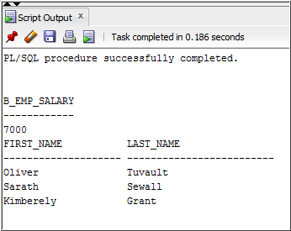
Bind Variables: Examples
        VARIABLE b_emp_salary NUMBER
        BEGIN
        SELECT salary INTO :b_emp_salary
        FROM employees WHERE employee_id = 178;
        END;
        /
        PRINT b_emp_salary
        SELECT first_name, last_name
        FROM employees
        WHERE salary=:b_emp_salary;

Slide 28
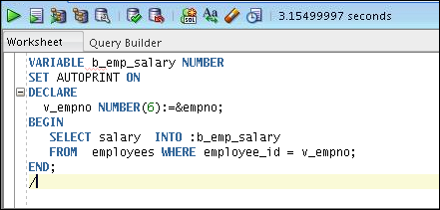
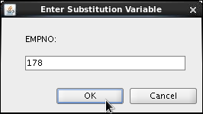
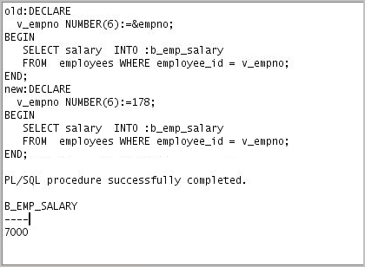
Using AUTOPRINT with Bind Variables

Slide 29
Quiz
The %TYPE attribute:
  Is used to declare a variable according to a database column definition
  Is used to declare a variable according to a collection of columns in a database table or view
  Is used to declare a variable according to the definition of another declared variable
  Is prefixed with the database table and column names or the name of the declared variable

Slide 30
Summary
In this lesson, you should have learned how to:
  Recognize valid and invalid identifiers
  Declare variables in the declarative section of a PL/SQL block
  Initialize variables and use them in the executable section
  Differentiate between scalar and composite data types
  Use the %TYPE attribute
  Use bind variables

